Slide 1
When To Wave Off Landing Data in PaaS Services
Matt Gordon, Senior Architect, Centric Consulting
Joey D'Antoni, Principal Consultant, DCAC
You can also talk to us about race cars!

Slide 2


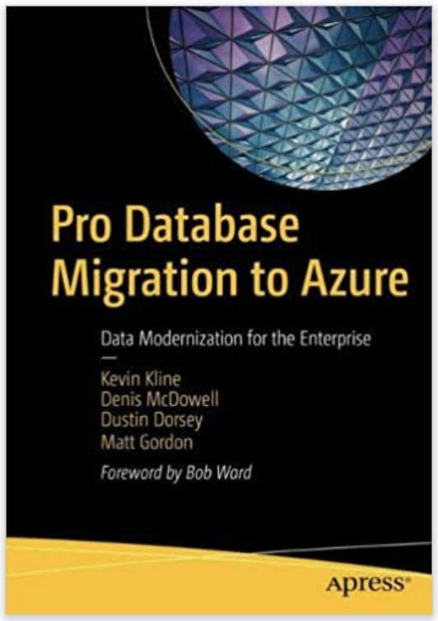
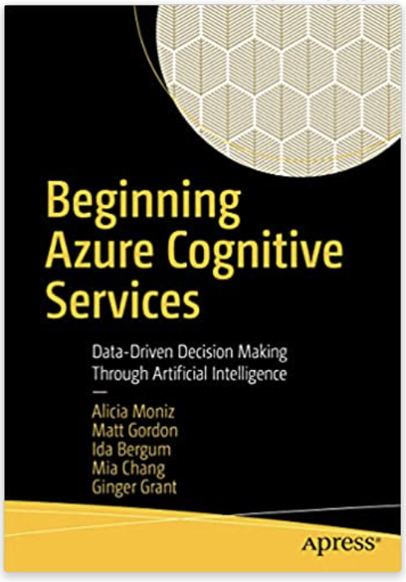
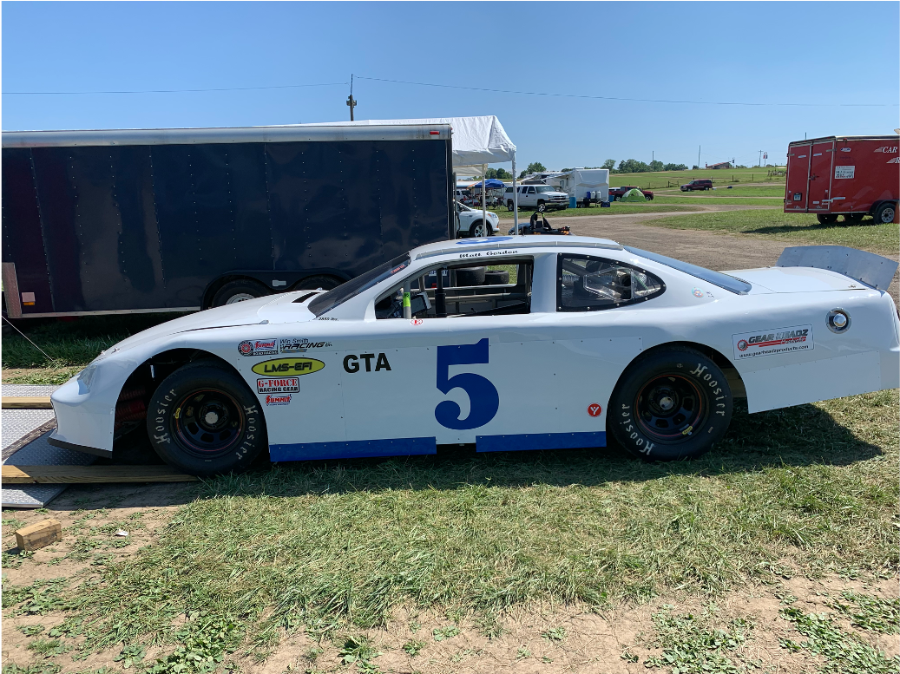

Matt Gordon
Senior Architect
matt@sqlatspeed.com
: @sqlatspeed
www.sqlatspeed.com

Slide 3



Joey D’Antoni
MCSE, MCT, Data Platform and Analytics, 20 years of experience with SQL Server.
MICROSOFT MVP
Data Platform MVP, 2013-current. VMWare vExpert
Principal Consultant, Denny Cherry and Associates Consulting
AUTHOR INTRODUCING SQL SERVER 2016
Among other white papers and articles on SQL Sever, Azure SQL Database, and other topics.
/josephdantoni
@jdanton
joeydantoni

Slide 4

PAAS Services?

Slide 5
The Services We Are Talking About
Azure SQL DB
Azure SQL Managed Instance
Cosmos DB
Amazon RDS
Amazon Aurora (not much)

Slide 6
Value Proposition of PaaS

Slide 7
Speaking Generally
Pre-configured
Automatic HA/Backups
No Patching

Slide 8
No Installations
In theory, this means you can deploy as needed and delete as needed*
Don’t have to worry about grabbing the latest version of software
This benefit is somewhat limited given how good SQL Server on Azure VM is now.
*Both MI and RDS take *hours* to deploy
Notes:
It just spins up and it just works…creates all necessary resources for you (and then manages them)
Mostly* configured with best practices

Slide 9
What is the Value Proposition of the Cloud?
IaaS
Nearly infinite compute and storage
High availability—typically uptimes are higher than on-premises
Virtual networking—which helps drives automation
PaaS
This varies much by each service
However, these are the common architectural tenets
Built-in service level HA
Platform driven backups
Automated patching
Evergreen software
DR is usually available, but at additional costs
It is important to understand the nuances of each service
Notes:
SPLIT INTO THREE SLIDES
Patches itself (bullets about maintenance windows and disruptions…contrast Azure SQL behavior with MI)
HA is built-in* (talk about multi-region)
Backups are handled (MI pretty much uses backup-to-URL like you can on-prem) (talk about Hyperscale here?)
Do we still need to split?

Slide 10
Backups
The number 1 commandment of the cloud: “Read thy documentation”
Not all backups are the same (Azure SQL* is very good at this, RDS, less so)
Make sure you understand what the recovery point objective (RPO) of the service is
Notes:
Reminder that MI pretty much uses the same backup-to-URL technology that you can use in your IaaS environments

Slide 11
High Availability
Nearly all PaaS services offer high availability in some form
Some work better than others
Understanding how failure/failover works in the service is critical to your app
The cloud works really great, except when it doesn’t
Notes:
Talk about multi-region deployment being necessary for truly high-level high availability

Slide 12
Patching
Most PaaS services have automated patching
Azure SQL DB can do zero-downtime patching, where .dlls are replaced in running memory
Azure SQL MI does not
RDS is also not great at patching
Notes:
Understand maintenance windows and the possible impact those can have...the cloud is great, but not necessarily perfect
Mistakes can happen and odd behaviors can result from maintenance – be prepared

Slide 13

Optional DR
Another tenet of cloud computing is that DR is typically one click away
However, it’s never free
Notes:
Your DR options are wide open (backup to geo-replicated storage account, restore to MI in that region, MI “failover groups”)
In a PaaS service, your only DR option generally resides within the service (except for MI link)
“once you go PaaS, stay with PaaS”
Talk about some examples
Talk about MI link (two-way only on 22, one-way only on 16 and 19)

Slide 14
Infrastructure
Networking
Performance
Storage
Notes:
MI requires a stronger understanding of networking (Azure SQL is starting to “catch up” in this area)
MI deploys privately, Azure SQL deploys publicly (by default)
Go to docs page that shows the resource limits
Maybe three bullets (networking, performance, storage)

Slide 15
Deeper Dive Into Azure SQL Storage
General Purpose and Business Critical have different storage modes
Size matters (in general purpose)
If you spend more money (business critical), size doesn’t matter (except when it does)

Slide 16
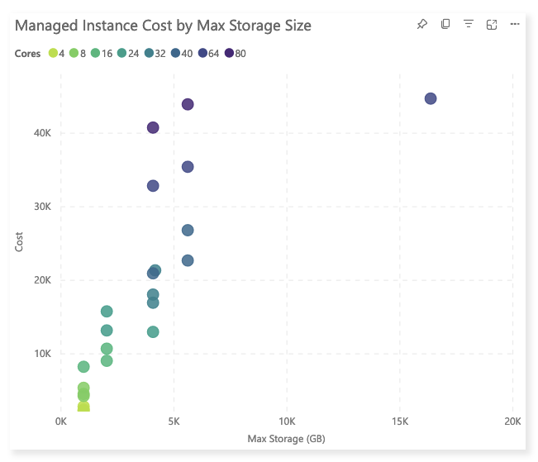
Cost Risks

Slide 17
Risks of Managed Instance/RDS

Slide 18
Technological Risks
Loss of control
Hardware issues
Bug-ish behavior
Support issues
Tempdb issues
12 files regardless of core count
No in-memory option
Storage performance not really tunable
Size of tempdb can cut into capacity for DBs
Notes:
Loss of control (hardware issues, bug-ish behavior, support issues)
Tempdb issues (just 12 files regardless of core count, no in-memory option, storage performance is not really tunable, size of tempdb can cut into capacity of your DBs)

Slide 19
PaaS Decision Points

Slide 20
Cost of Scaling
CPU and memory are paired together
You're paying for something you may not need
Big horsepower requires big dollars
Those big dollars may not guarantee a reliable experience
Notes:
CPU/memory are paired together even if your workload only wants a lot of one of those things
MAYBE SHOW PROVISIONING DEMO/WALKTHROGH HERE?
Exponential increases with big horsepower
Talk about rev issue with pushing CPU limits

Slide 21
Criticality to the Business
Does the number of nines the service supports agree with the number of nines in your SLA?
Can you manage the platform to keep it as available as it needs to be?
Is sheer speed/performance critical to what you're offering users?
Notes:
Does the number of nines in the service equal the number of nines in your contract?
Do you understand how to manage the platform well enough to keep it as available as it needs to be
Is the sheer speed of the database platform critical to what you’re offering users?

Slide 22
Cost/Benefit Analysis
Possibly fewer general IT/operations personnel
No need to worry about datacenter costs
Reservations save costs and give the accountants the ability to amortize
Does the cost of your service cover the cost of the cloud?
You will likely run the on-premises and cloud environments together for a period of time
Notes:
Possibly fewer general IT/operations folks
No need to worry about datacenter overhead
Reservations not only save costs but give the accountants the ability to amortize – but you’re locked in for a while

Slide 23
When to Choose a PaaS Service?
Standard lawyer/doctor/consultant rule: it depends, but:
When you have a low risk, median workload application that you want to offload
When you are building a net new app/service with that PaaS service in mind
When you’ve test a critical workload extensively and you understand your growth and exit plans
DR, maybe? (Probably not)

Slide 24
When Not to Choose a PaaS Service?
Because the CIO wants to be in the keynote at Ignite
When someone who can’t spell SQL Server decides to move a business critical app into RDS
To Save Money
To scale performance up/down to save money

Slide 25
Contact Info
Joey: joeydantoni.com
joey@dcac.com
@jdanton
Matt: sqlatspeed.com
matt@sqlatspeed.com
@sqlatspeed

